Slide 1
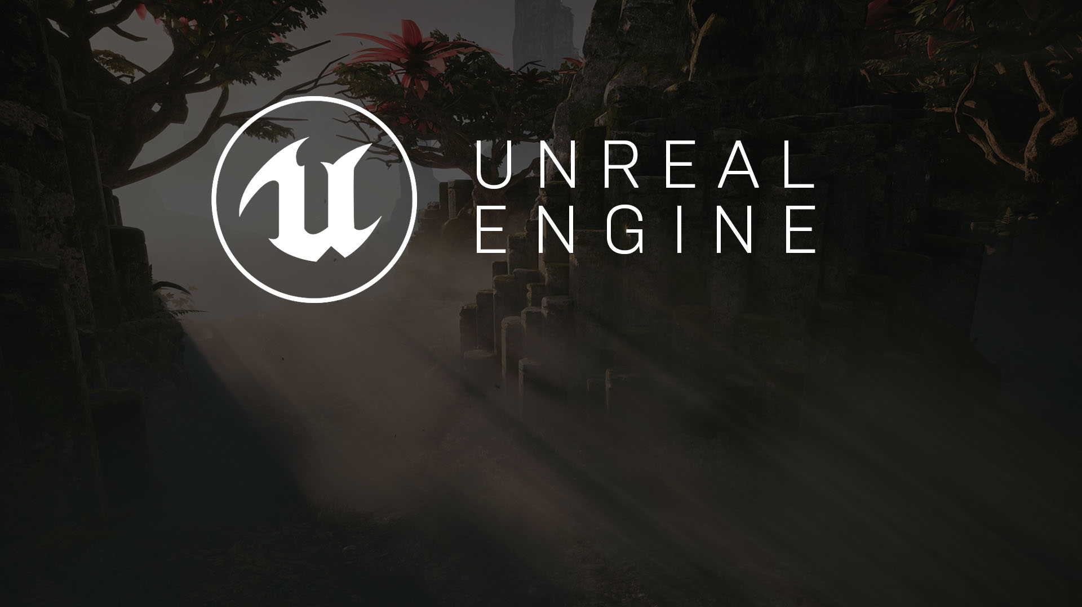
MULTIPLAYER #2
More Replication

Slide 2

Network Mode | Description
Standalone | The game is running as a server that does not accept connections from remote clients. Any players participating in the game are strictly local players. This mode is used for single-player and local multiplayer games. It will run both server-side logic and client-side logic as appropriate for the local players.
Client | The game is running as a client that is connected to a server in a network multiplayer session. It will not run any server-side logic.
Listen Server | The game is running as a server hosting a network multiplayer session. It accepts connections from remote clients and has local players directly on the server. This mode is often used for casual cooperative and competitive multiplayer.
Dedicated Server | The game is running as a server hosting a network multiplayer session. It accepts connections from remote clients, but has no local players, so it discards graphics, sound, input, and other other player-oriented features in order to run more efficiently. This mode is often used for games requiring more persistent, secure, or large-scale multiplayer.
Network Modes and Server Types

Slide 3
Easy to set up and play
In-game UI to start a server and other to join
Concerns about fairness and cheating!
Extra processing
Less suitable for games in highly competitive settings or games with very high network loads!
Very convenient for casual cooperative and competitive multiplayer among a small group of players.
Does not require a separate binary to play.
Listen Servers

Slide 4
More expensive and difficult to configure
Requiring a separate computer with its own network connection.
Ensures fairness.
Process gameplay and networking more efficiently.
Preferable for games requiring a large number of players or games requiring a high-performing, trusted server for either security, fairness, or reliability reasons.
Suitable for MMOs, competitive MOBAs, or fast-paced online shooters.
Requires an extra binary which built using source code version of UE.
Dedicated Servers

Slide 5
Creation, destruction, and movement handled automatically.
All other gameplay features do not automatically replicate by default!
You must designate exactly which variables and functions you want to replicate as is appropriate to your game.
Several common features of Actors, Pawns, and Characters DO NOT replicate:
Skeletal Mesh and Static Mesh Components
Materials
Animation Blueprints
Particle Systems
Sound Emitters
Physics Objects
Each of these runs separately on all clients. However, if the variables that drive these visual elements are replicated, it will ensure that all client has the same information and therefore simulates them in approximately the same way.
More Replication...

Slide 6
Network Role | Description
None | The Actor has no role in a network game and does not replicate.
Authority | The Actor is authoritative and replicates its information to remote proxies of it on other machines.
Simulated Proxy | The Actor is a remote proxy that is controlled entirely by an authoritative Actor on another machine. Most Actors in a network game, like pickups, projectiles, or interactive objects, will appear as Simulated Proxies on remote clients.
Autonomous Proxy | The Actor is a remote proxy that is capable of performing some functions locally, but receives corrections from an authoritative Actor. Autonomous Proxy is usually reserved for Actors under the direct control of a player, like Pawns.
Network Role and Authority

Slide 7
Relevance is used to determine whether or not it is worthwhile to replicate an Actor during a multiplayer game.
Actors that are not considered relevant are culled during replication. This saves bandwidth so that Actors that are relevant can replicate more efficiently.
If an Actor is not owned by any players and not physically near any players, then it is not considered relevant and does not replicate.
Non-relevant Actors still exist on the server and can affect the authoritative game state, but do not send information to clients until players are nearby. You can manually control relevance by overriding the IsNetRelevantFor function, and you can determine the distance at which an Actor is relevant using the NetCullDistanceSquared property.
Sometimes there is not enough bandwidth available to replicate all relevant Actors during a single frame of gameplay.
Actors therefore have a Priority value which determines which Actors get to replicate first.
By default, Pawns and PlayerControllers have a NetPriority of 3.0, which makes them the highest-priority Actors in a game, while base Actors have a NetPriority of 1.0.
Relevance and Priority

Slide 8
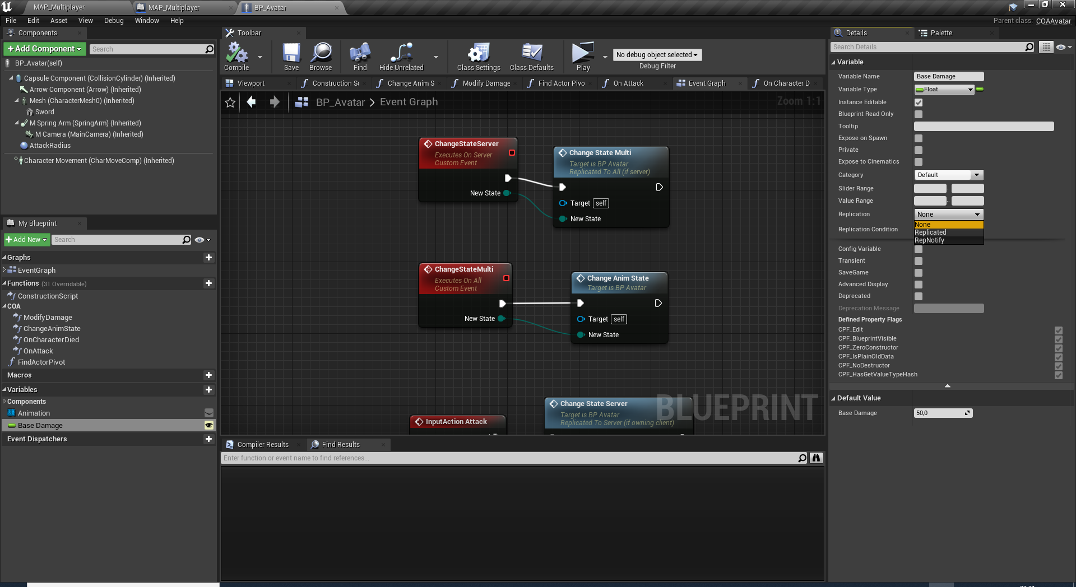
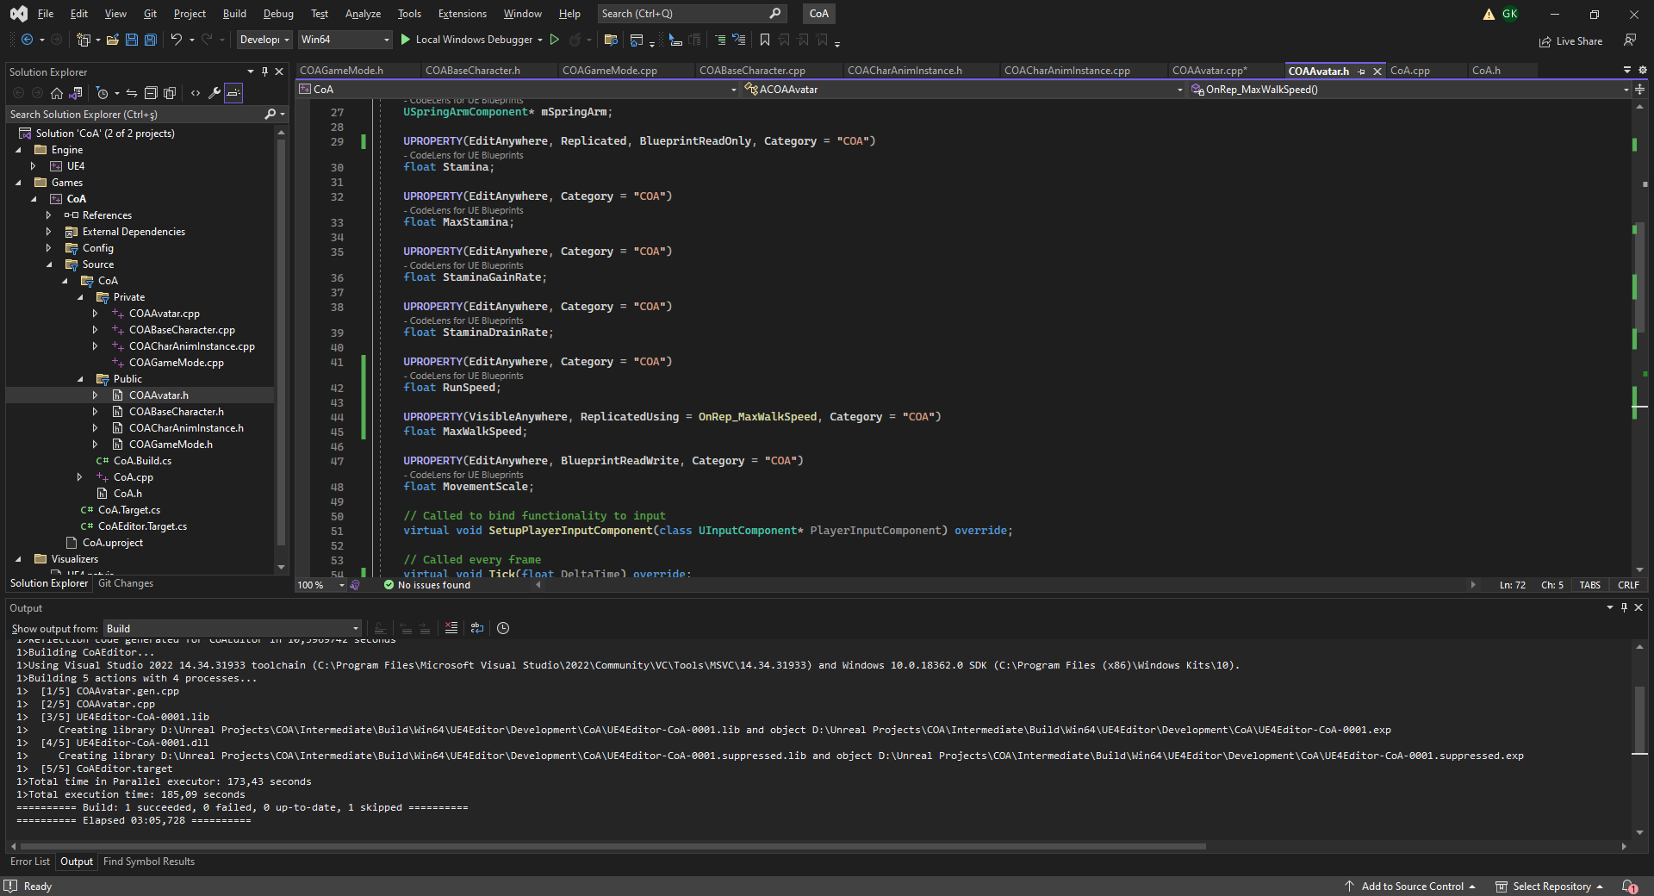
Replicated
ReplicateUsing
Whenever a replicated variable's value changes on an authoritative Actor, its information is automatically sent from the authoriative Actor to the remote proxies connected to the session.
RepNotifies
You can designate a RepNotify function that will be called in response to an Actor successfully receiving replicated information for specific variables.
RepNotifies only trigger locally when a variable is updated, making them a low-overhead way to trigger gameplay logic in response to variable changes on an authoritative Actor.
You can access this functionality by using the ReplicatedUsing specifier in a variable's UPROPERTY macro in C++, or by changing the Replication setting for the variable in Blueprint to use a RepNotify.
RepNotifies are preferable over using RPCs or replicated functions, as they can be added to variables that you would need to replicate regardless of other gameplay functionality, saving a significant amount of bandwidth over creating additional network calls.
Variable Replication

Slide 9
RELIABILITY
For any replicated event, you can choose whether it is Reliable or Unreliable.
Reliable events (TCP based) are guaranteed to reach their destination (assuming the ownership rules above are followed), but they introduce more bandwidth, and potentially latency, to meet this guarantee.
Try to avoid sending reliable events too often, such as on every tick, since the engine's internal buffer of reliable events may overflow - when this happens, the associated player will be disconnected!
Unreliable events (UDP Based) work as their name implies - they may not reach their destination, in case of packet loss on the network, or if the engine determines there is a lot of higher-priority traffic it needs to send, for example. As a result, unreliable events use less bandwidth than reliable events, and they can be called safely more often.

Slide 10
Set the Actor's Replicated setting to True.
If the replicated Actor needs to move, set Replicates Movement to True.
When you spawn or destroy a replicated Actor, ensure that you do it on the server.
Set any variables that must be shared between machines to replicate. This usually applies to gameplay-essential variables.
Use Unreal Engine's pre-made Movement Components whenever possible, as they are already built for replication.
If you are using a server-authoritative model, make sure any new actions that the player can perform are triggered by Server functions.
Replication Checklist

Slide 11
Use as few RPCs or replicated Blueprint functions as possible. If you can use a RepNotify instead, you should.
Use Multicast functions especially sparingly, as they create extra network traffic for each connected client in a session.
Server-only logic does not necessarily have to be contained in a server RPC if you can guarantee that a non-replicated function will only execute on the server.
Be cautious when binding Reliable RPCs to player input. Players can repeatedly press buttons very rapidly, and that will overflow the queue for Reliable RPCs. You should use some way of limiting how often players can activate these.
If your game calls an RPC or replicated function very often, such as on Tick, you should make it Unreliable.
Networking Tips

Slide 12
COA REPLICATION WITH VARIABLES
So far we utilized RPCs to sychronize gameplay between clients and the server.
What if we used replicated variables?

Slide 13
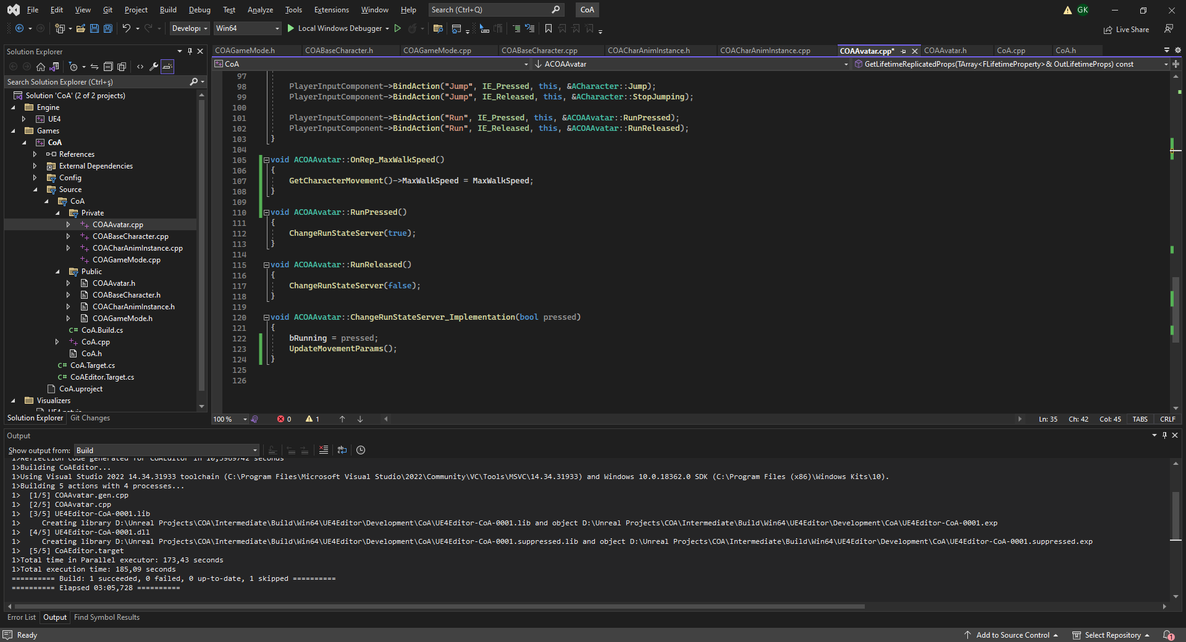
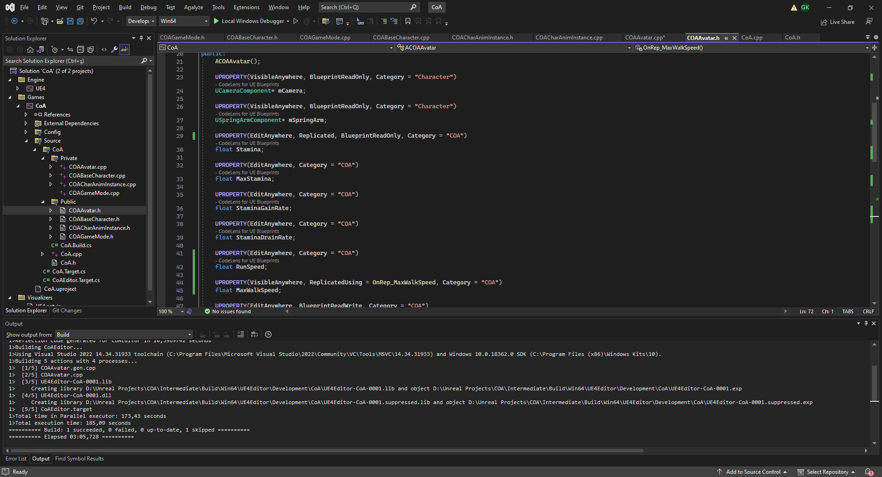
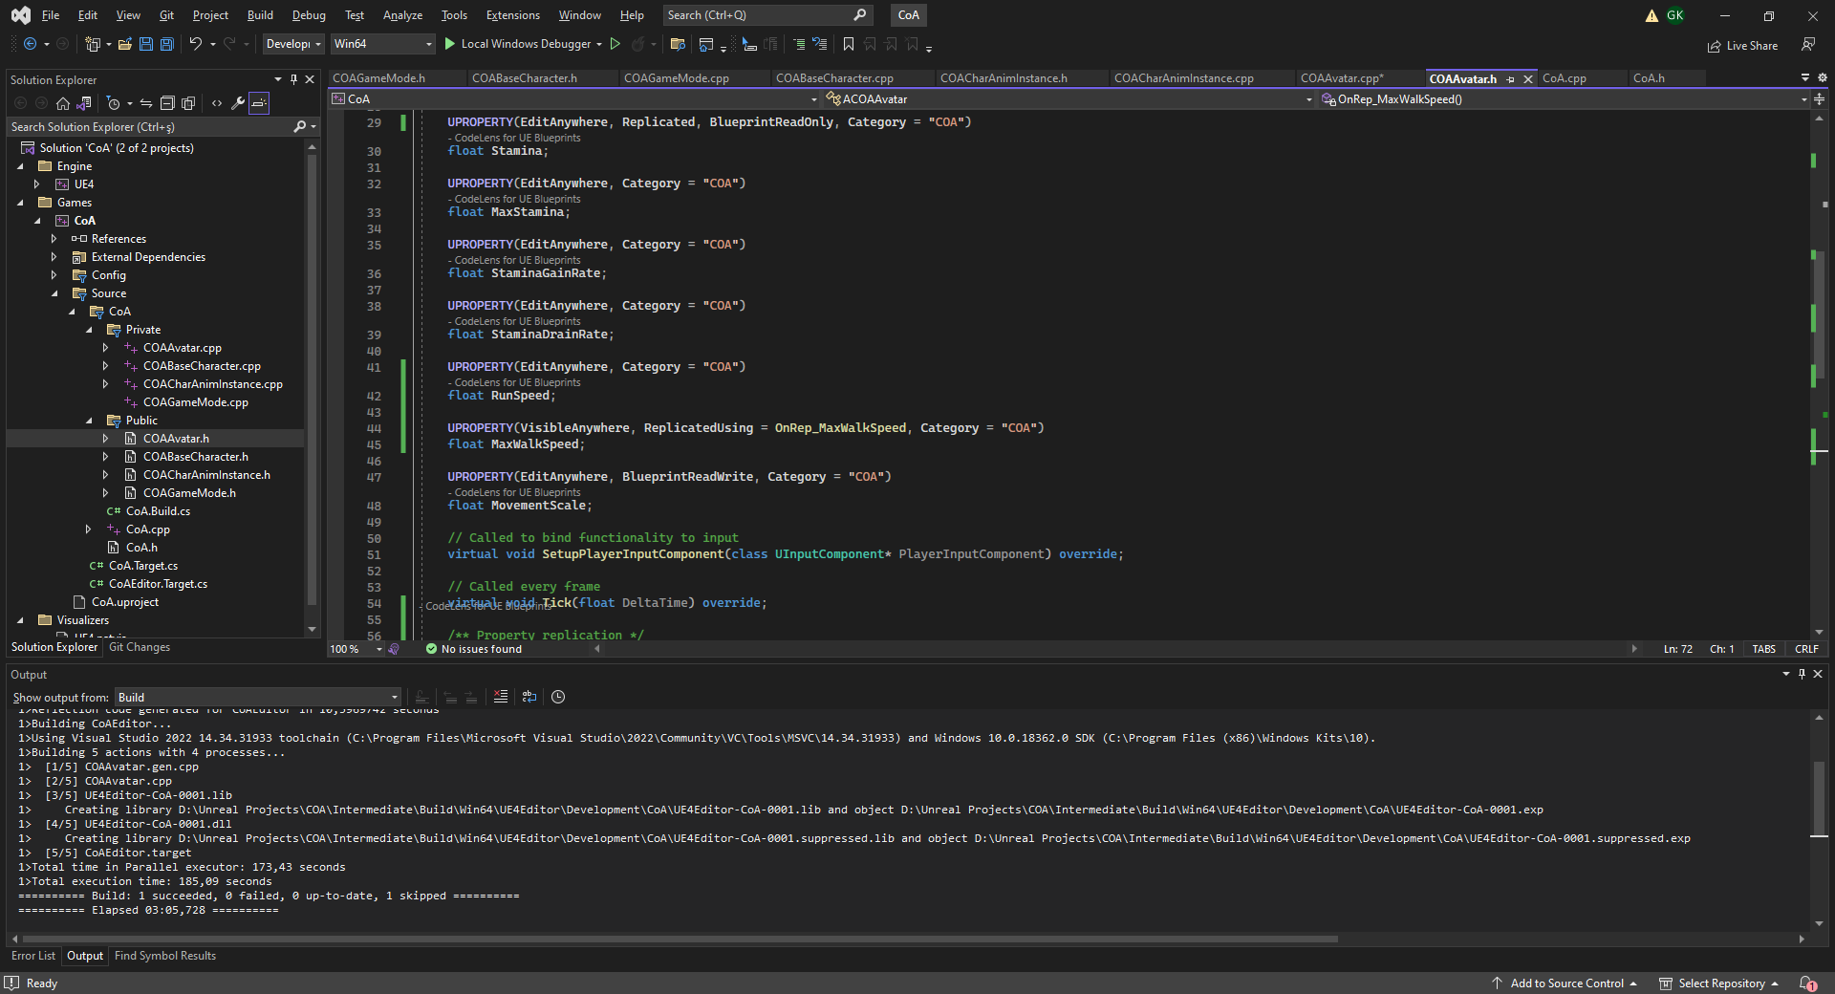
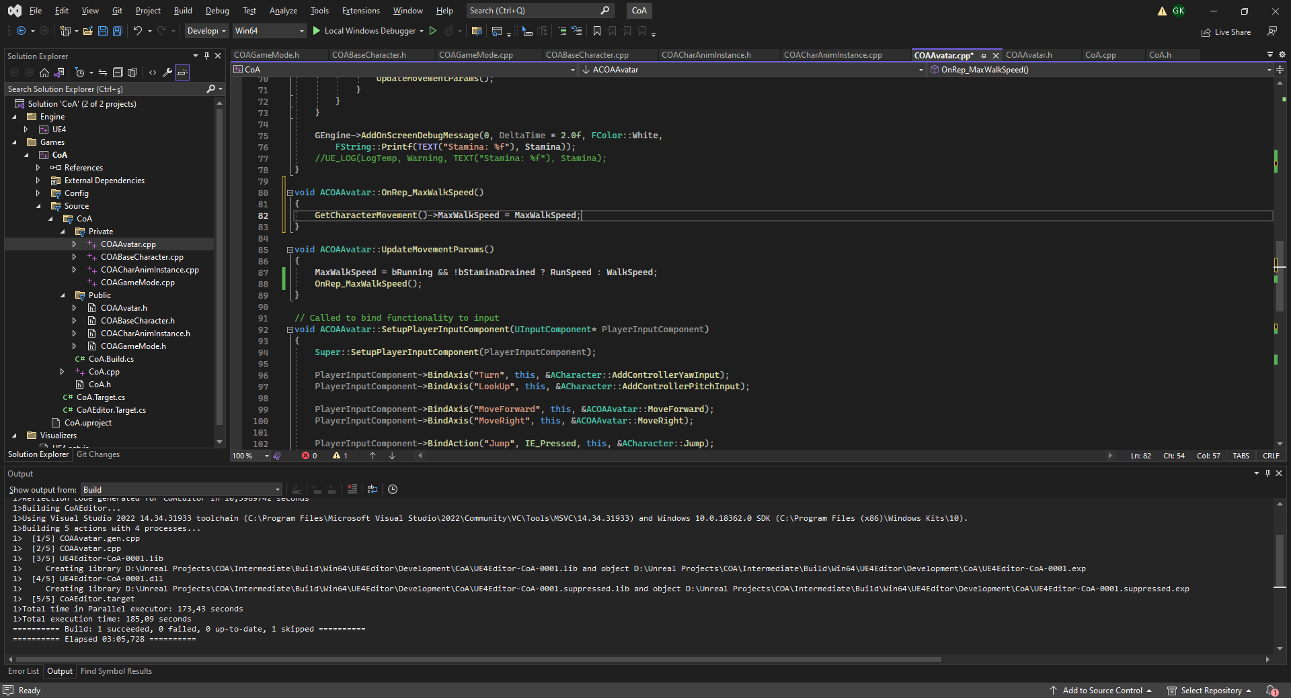
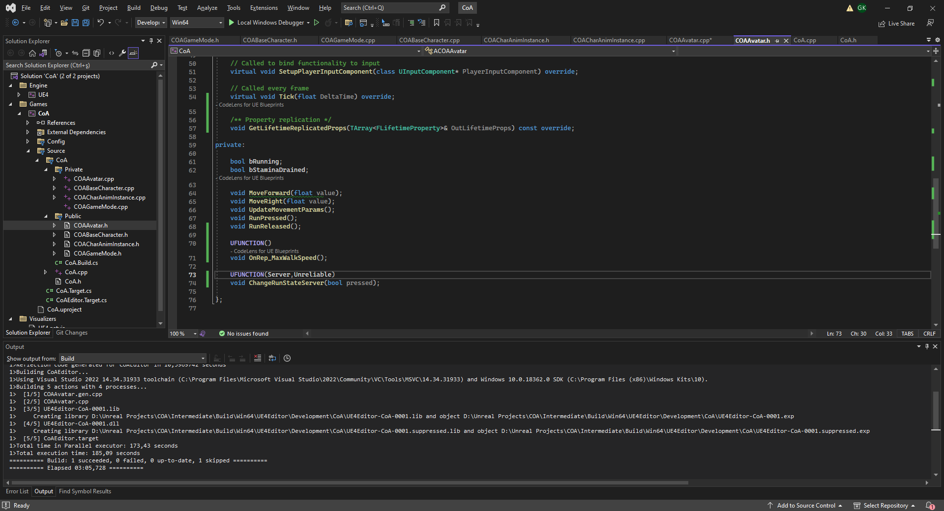
COA RUNNING WITHOUT SERVER MULTICAST
Remove ChangeRunStateMulticast()
Make Stamina a Replicated variable.
Add MaxWalkSpeed variable and make it Replicate with OnRep_MaxWalkSpeed function.
Let’s change ChangeRunStateServer() RPC an Unreliable one… For optimization…
Move update of CharacterMovement MaxWalkSpeed into OnRep notifier and Change UpdateMovementParams() to call the rep function.

Slide 14
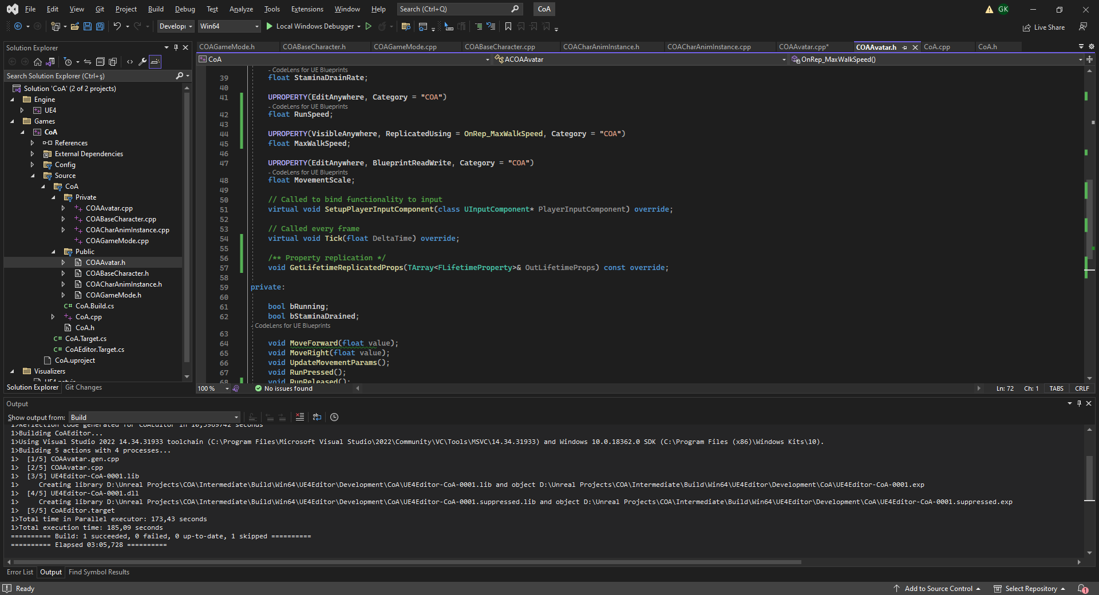
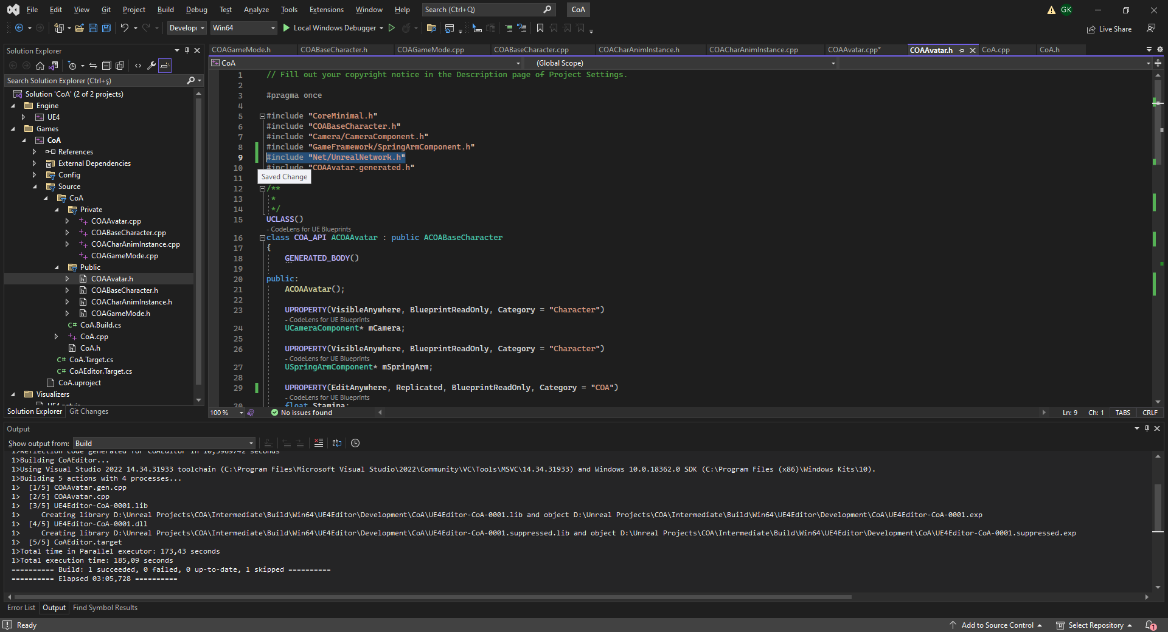
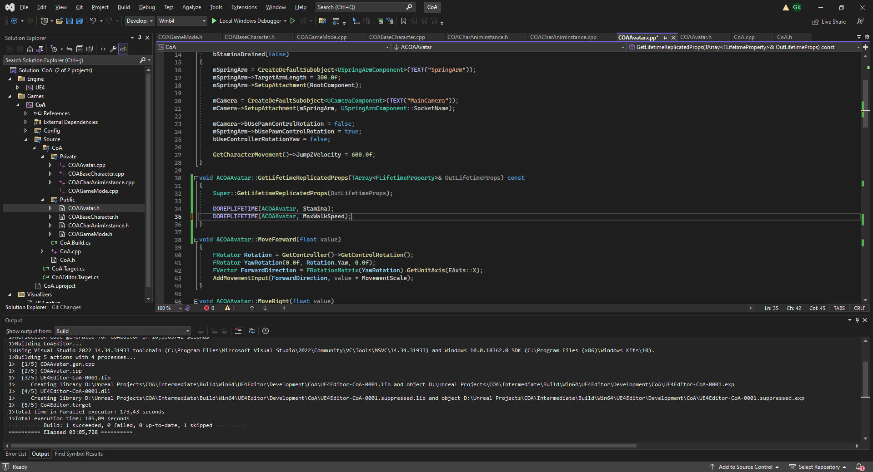
C++ Variable Replication Code
We need to override GetLifetimeReplicatedProps() to make variable replication work on C++.
Make sure to call its Super on implementation!
Use DOREPLIFETIME macro to register each variable one by one.
You will need to #include «Net/UnrealNetwork.h» in Avatar.h to use this macro.

Slide 15
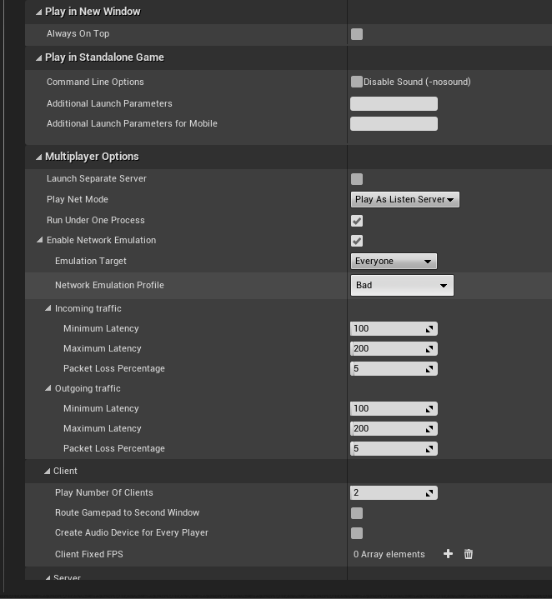
TESTING NEW RUNNING
It looks like we are able to run nicely of server and client side now!
Now let’s test it with a BAD connection with packet loss!
WHAT’S HAPPENING NOW???
HOW WOULD YOU SOLVE IT?

Slide 16
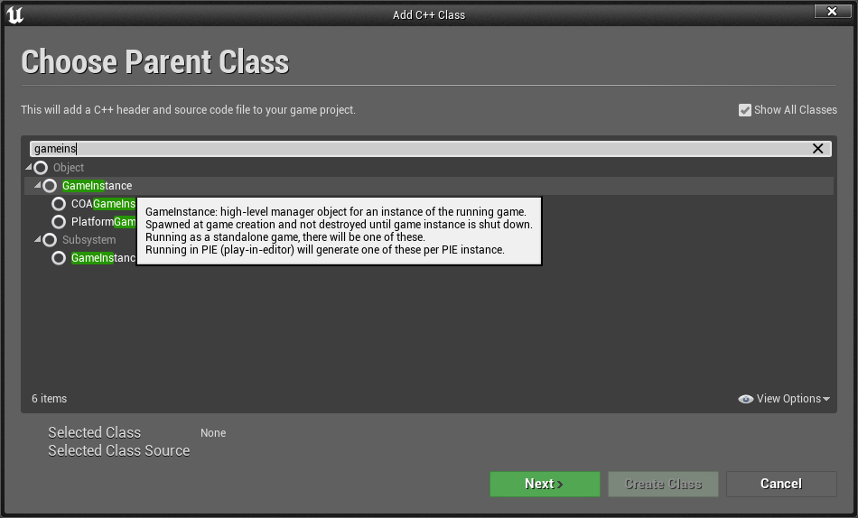
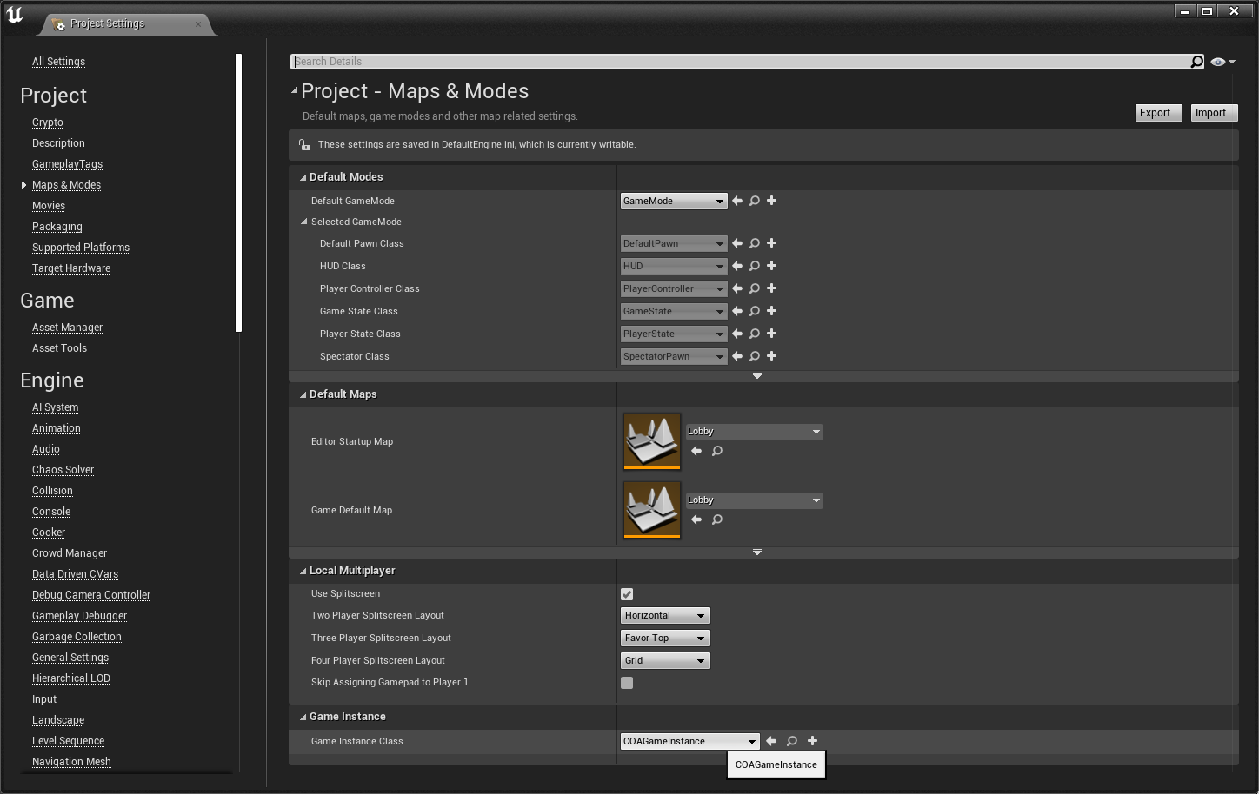
GAMEINSTANCE
GameInstance can be used to store global state.
It can register console commands!
Add a new C++ class deriving from GameInstance called «COAGameInstance»
Set the new class as the project’s GameInstance class from Project Settings/Maps & Modes section.

Slide 17
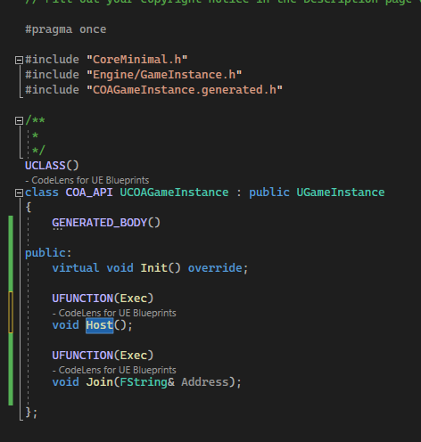
GAMEINSTANCE
Exec keyword provides custom console commands for your game.
Typing host would execute the Host() function on your game Instance here.

Slide 18
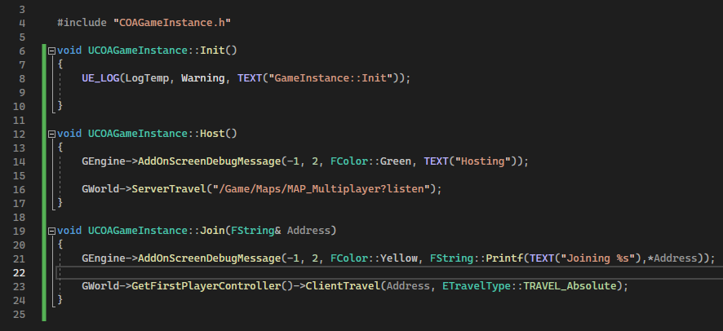
Gworld->ServerTravel() moves all playercontrollers to a new map.
PlayerController->ClientTravel() moves a player to another listening server.
Beware of «?listen» parameter on ServerTravel, it enables listen mode for your server.
GAMEINSTANCE

Slide 19
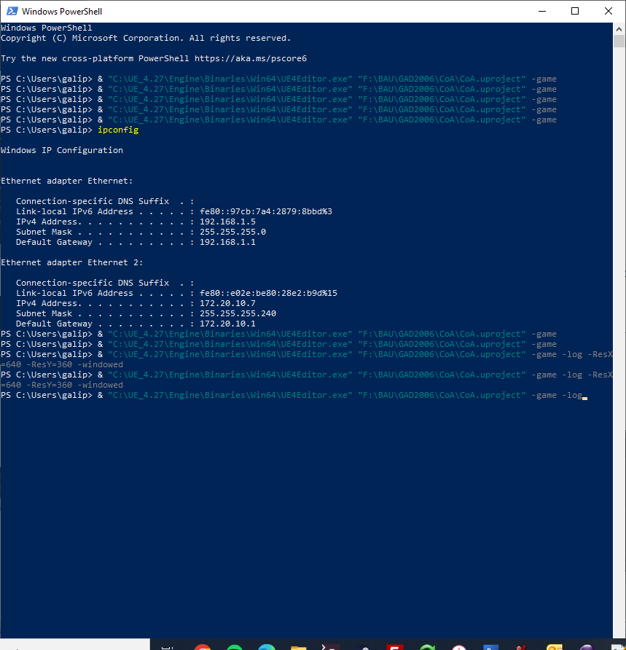
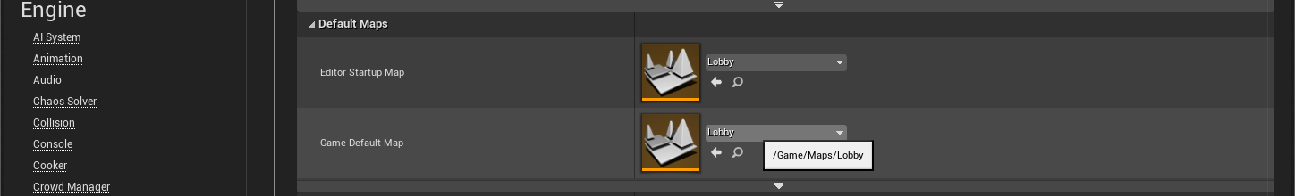
THE LOBBY
Create an empty Lobby map under Maps folder and set it as Game’s default Entry map on Project Settings.
Run WindowsPowerShell by typing its name on Windows Search Bar. (Starting with «&»)
BEWARE: You UE4Editor.exe and .uproject file locations are up to you to find!
This line of code runs your project in Stand Alone mode with console enabled.

Slide 20

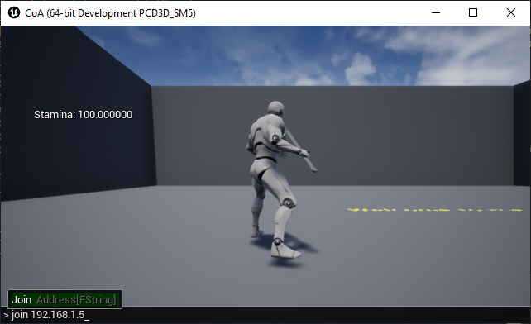
HOSTING AND JOINING
Learn your local IP address using ipconfig command.
Start 2 instances of your game by double executing the command line.
On first, open up console and execute host command.
On the second open up console and execute join <IPAdress>
Both instances should join each other and should be playing.

Slide 21
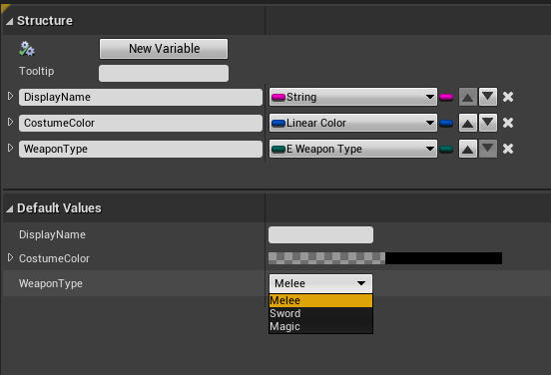
PASSING PLAYER DATA
GameInstance can be utilized to store player specific data before entering a multiplayer game. Such as customization options, stats, weapon choices..etc
GameState can be used to store each players data open to all players.
All player specific data could be groupped in a structure.
Place a PlayerSettings structure variable both into GameInstance and GameState classes of your game.

Slide 22
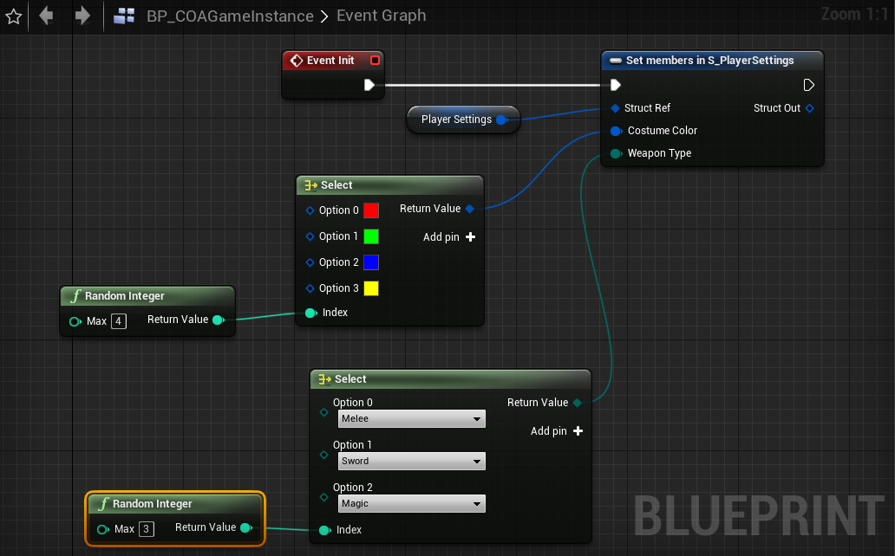
Let’s generate random PlayerSettings when GameInstance is created with Init()
GENERATING PLAYER DATA

Slide 23
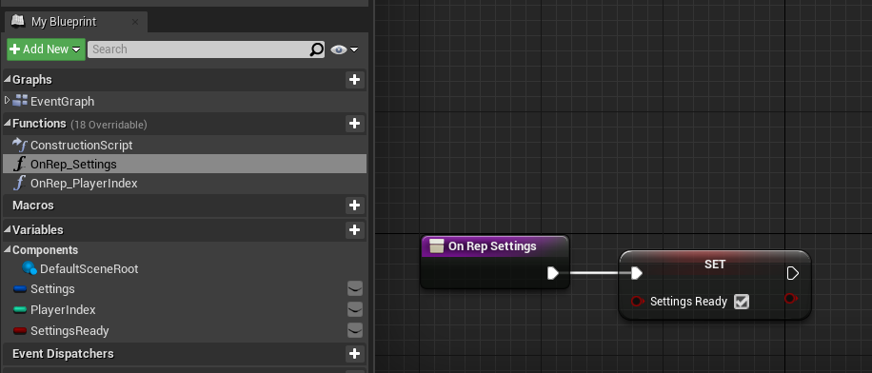
Each GameState will hold Settings data of the player and a PlayerIndex assigned by the GameMode.
Both Replicated variables use RepNotify Events.
BP_COAGAMESTATE

Slide 24
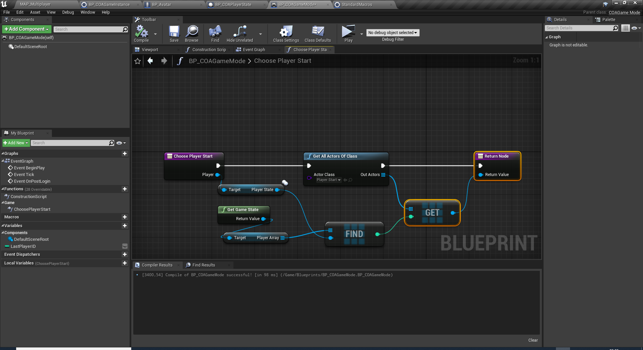
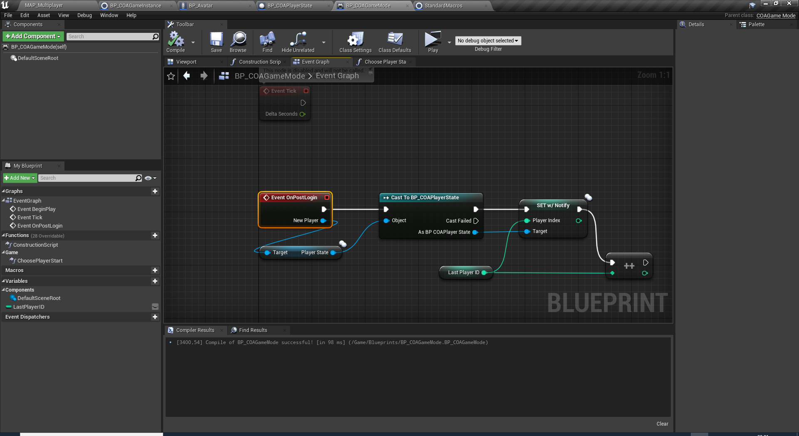
OnPostLogin event is called when a new player joins the server. Let’s assign a new index every time a player joints here.
ChoosePlayerStart function can be overwritten to assign different PlayerStart to each player.
BP_COAGAMEMODE

Slide 25
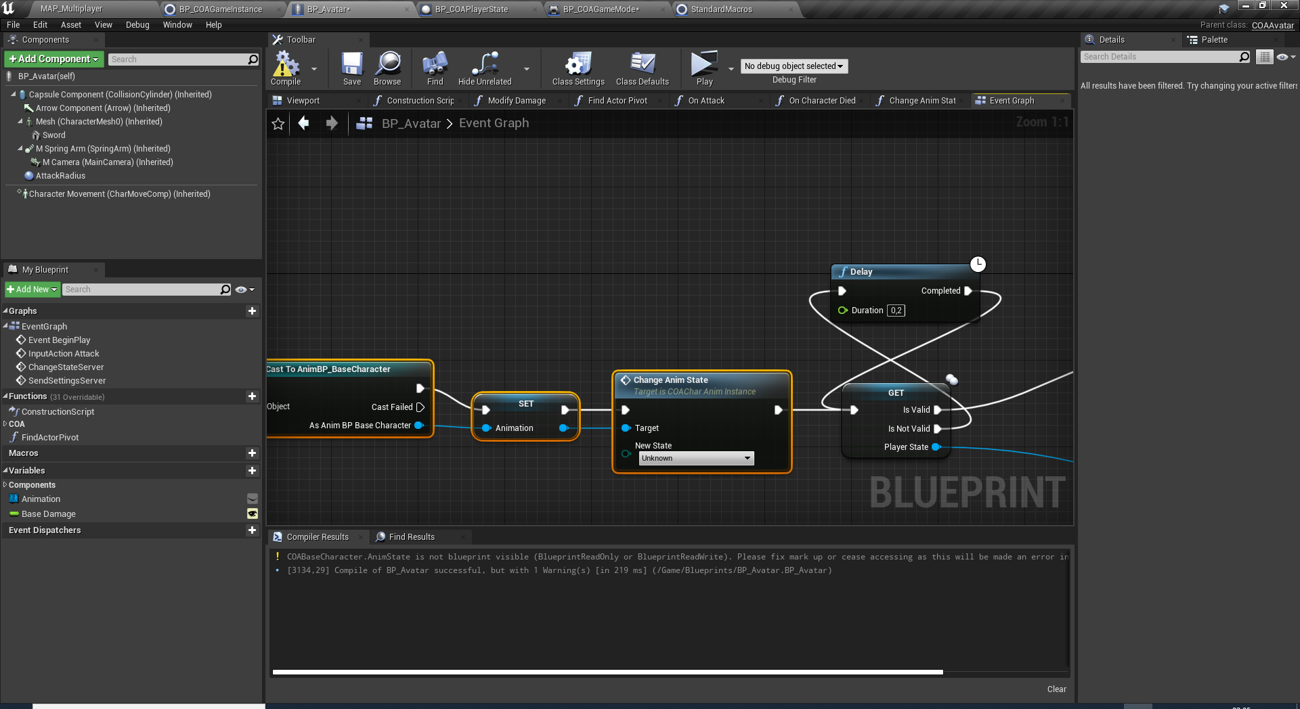
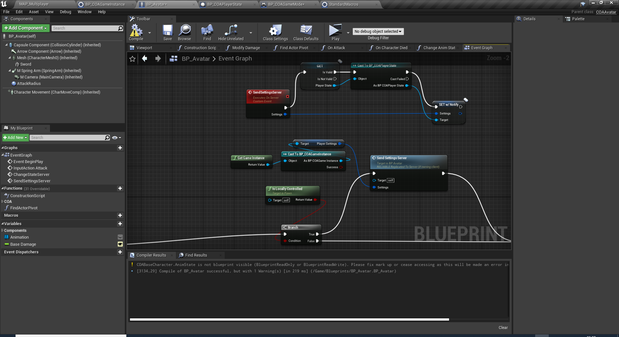
BP_AVATAR
BeginPlay event can be used to start exchanging Player Settings.
We should wait for PlayerState reference to be valid to start data exchance.
After we send our PlayerSettings stored in GameInstance if this the Avatar we are controlling with our PlayerController. IsLocallyControlled() function provides this information.
SendSettingsServer() is a reliable Run-On-Server type event which requests the client data to be updated and replicated to all clients.

Slide 26
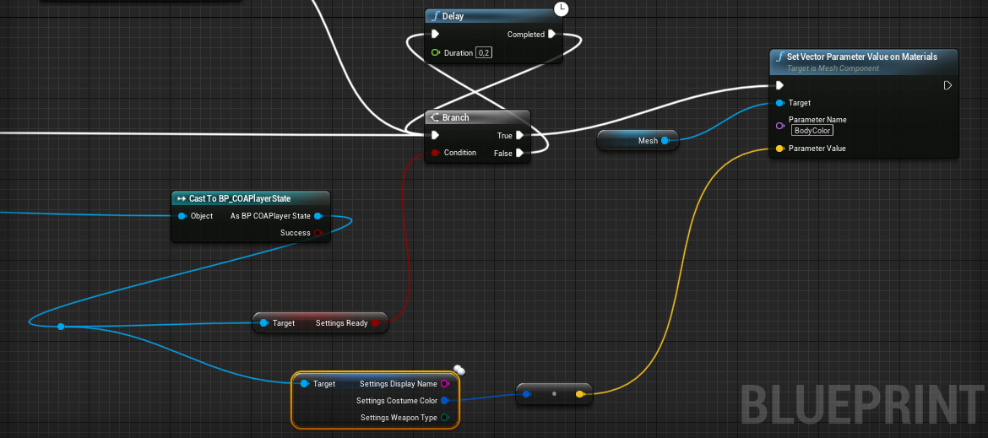
All clients should wait for the player settings to get replicated from the server.
SettingsReady flag is used for this.
Then we apply customization and gameplay settings to the current pawn/avatar.
BP_AVATAR

Slide 27
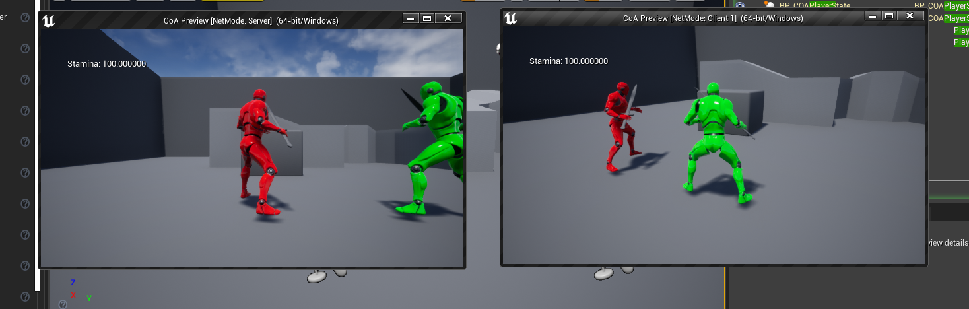
RESULT

Slide 28
DEADLINE:
20th December 2022 / 18:00
PLATFORM:
TEAMS
Required Folders to submit in a zip file:
1- /Source/
2- /Content/Blueprints
3- /Config/
4- Any new/extra assets used (for fireball etc..)
ASSIGNMENT #2:
Multiplayer with Player Settings and Weapon Selection
Implement Lobby map and MAP_Multiplayer with join and host console commands in COAGameInstance.
In the lobby, the player chooses a body color (out of 4 colors). This color is kept when they joined to a game or host one.
In the lobby, the player will also pick a weapon (out of a sword or throwing a fireball) by walking over hotspots (like pickups) assigned for both. The player will only be able to use that weapon throughout the multiplayer game.
Implement the throwing fireball mechanic with a server-side replicated blueprint. The fireball travels some distance, damages the player on hit, or may bump into static geometry and disappear. It also has a certain cooldown to prevent players from spamming it.
All mechanics’ logic should run on the server and the game shouldn’t desync.

Slide 29
Conclusion
Questions?

